Slide 1
FINAL PROJECT
CIT COURSE

Slide 2

my resume
I am open word and I select blank page . I am a decide my cv is simple and professional and select readable font include relevant details Professional summary ,Education , Skills , Experience unnecessary information not include and include proper heading proper spacing our alignment , Bullet point contact details on top overall design simple and professional and again cv read.

Slide 3
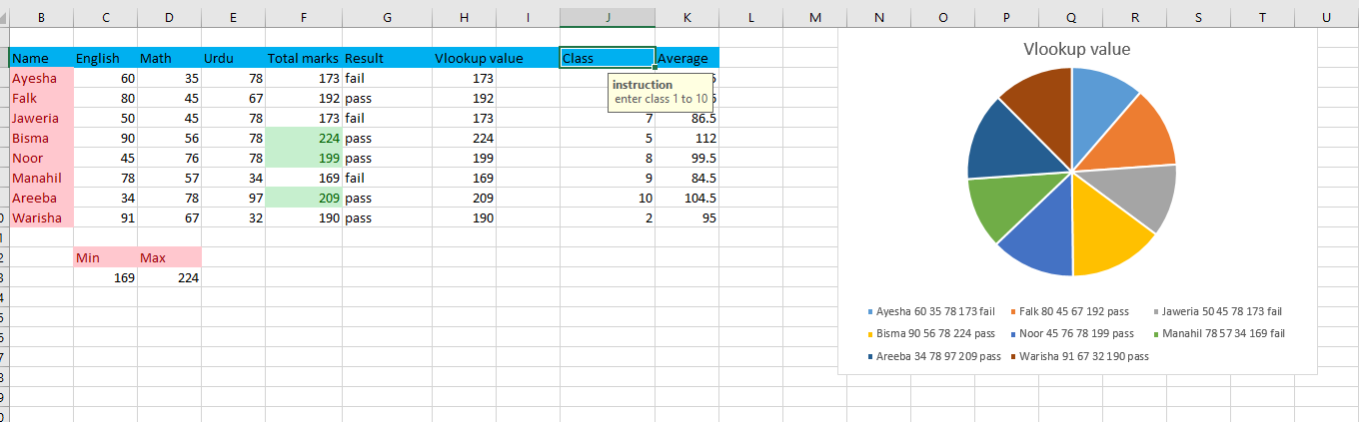
Spread sheet
We use spreadsheets because they make it easier to organize, calculate, and analyze large amounts of data in a simple and systematic way. A spreadsheet allows us to enter information in rows and columns, apply formulas to perform automatic calculations, and create charts or graphs for better visualization. It saves time by reducing manual work, helps in avoiding errors, and makes data more accurate and reliable. Spreadsheets are widely used in education, business, and personal tasks such as preparing budgets, recording student results, managing accounts, or tracking performance, making them a powerful tool for data management and decision-making.

Slide 4
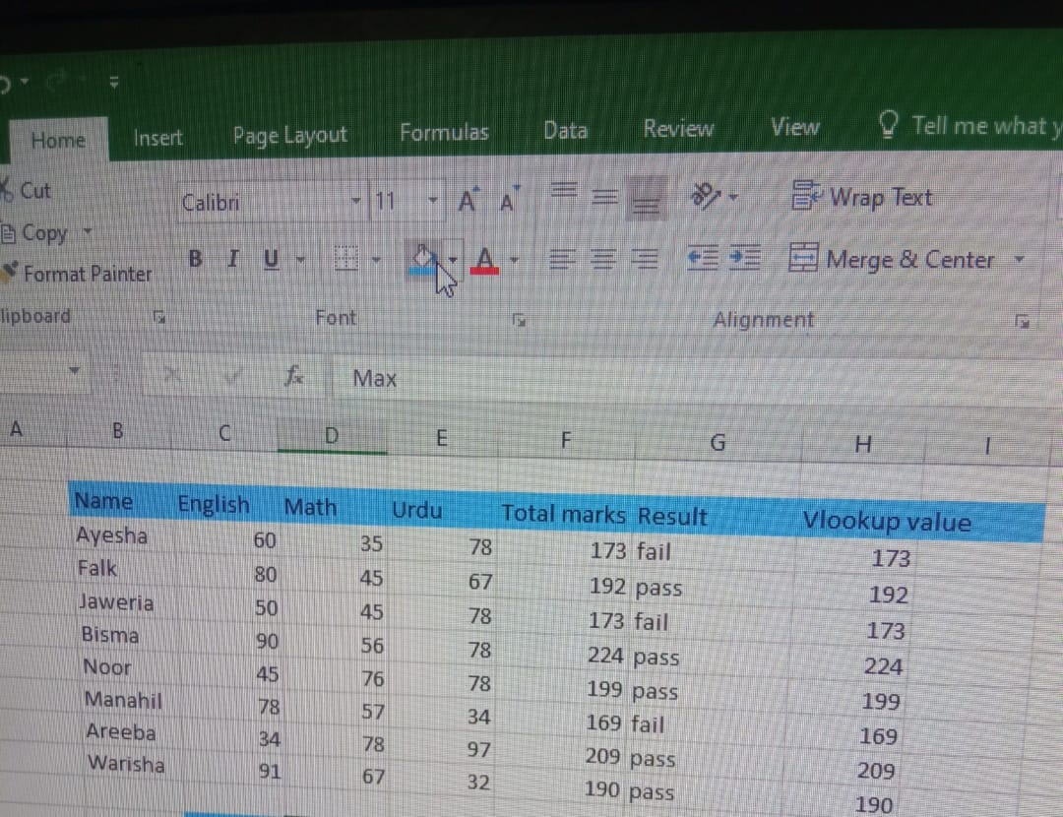
Sum ,vlookup and if formulas
We use formulas like SUM, VLOOKUP, and IF in Excel spreadsheets to make our work easier, faster, and more accurate. The SUM formula helps us quickly add up a range of numbers without doing manual calculations, which is useful for totals like marks, sales, or expenses. The VLOOKUP formula is used to search and bring specific information from a large dataset, saving time and avoiding mistakes when looking for details such as a student’s grade or a product’s price. The IF formula allows us to apply conditions and make logical decisions, for example, checking whether a student has passed or failed based on their marks. These formulas not only reduce human error but also increase efficiency, making Excel a very powerful tool for managing and analyzing data.

Slide 5
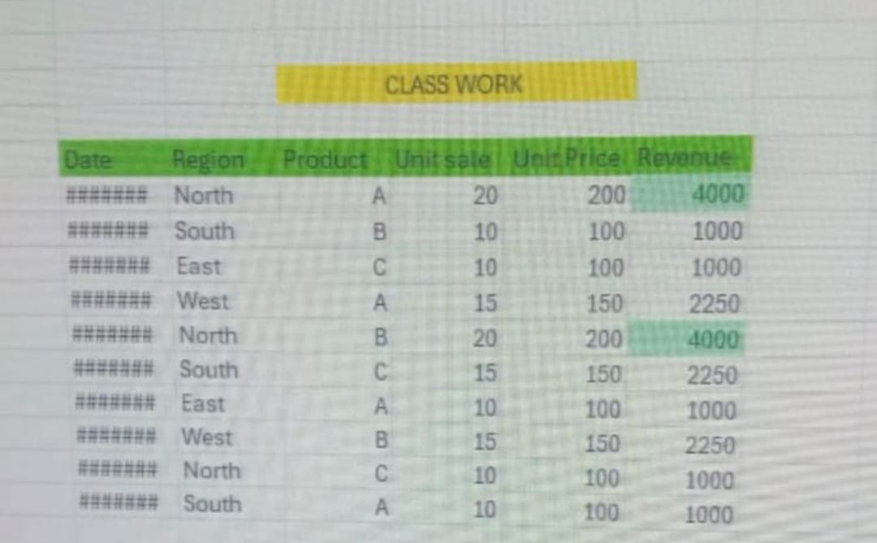
conditional formatting
In my spreadsheet, I applied conditional formatting to make the data easier to read and ana This helps me to compare results, identify trends, and spot errors without going through all the data manually. By using conditional formatting, my spreadsheet looks more organized, professional, and visually clear.lyze.

Slide 6
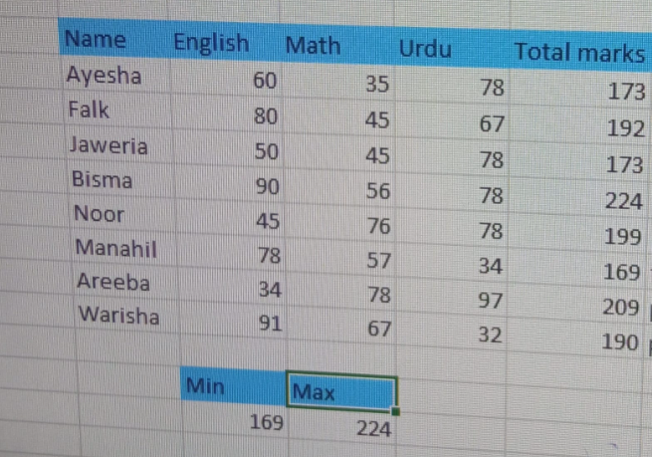
min and max
In my spreadsheet, I used the MIN and MAX functions in MS Excel to find the smallest and largest values from a range of data. The MIN function helps me quickly identify the lowest number, while the MAX function shows the highest number in the list. This is very useful when working with student marks, sales records, or any kind of numerical data because it saves time and reduces mistakes compared to checking values manually. By using these functions, I can easily analyze the performance, compare results, and understand the overall range of the data in my spreadsheet.

Slide 7
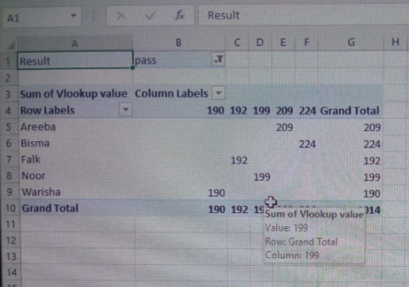
pivot table
In my spreadsheet, I created a Pivot Table to quickly summarize and analyze my data. A Pivot Table is a powerful tool in MS Excel that helps to arrange, group, and calculate large amounts of information in an organized way. Instead of checking data row by row, I can drag and drop fields to see totals, averages, or comparisons instantly. For example, it can show student results by subject, or sales by product, in a neat and clear format. By making a Pivot Table, my data became easier to understand, and I could find important insights without doing long calculations manually.

Slide 8
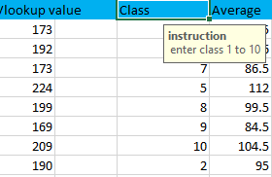
data validation
We use data validation in a spreadsheet to ensure that the information entered is accurate, consistent, and reliable. It helps to control the type of data or the values that users can input into a cell, such as allowing only numbers, dates, or values from a predefined list. By setting these rules, mistakes and invalid entries can be reduced, which improves the quality of the data. Data validation also makes the spreadsheet easier to use, as it guides users to enter correct values and prevents errors that could affect calculations or analysis.

Slide 9
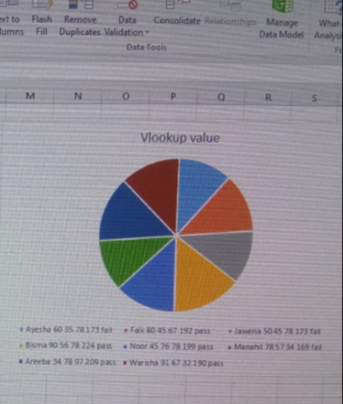
chart
I have made a spreadsheet for class students that includes 8 subjects, marks, and charts to clearly show the performance of each student. I also used the VLOOKUP function to quickly find and display specific student results from the data. This spreadsheet was made to organize student records, calculate results easily, and present the information in a clear and visual way through charts. We use spreadsheets because they save time, reduce errors, and make data analysis simple. I made it when I needed to manage student marks in an organized format and to present the performance in a professional and easy-to-understand manner

